Slide 1

PROJECT NAME : FILE Operation
Developed BY Manoj Kumar K

Slide 2
Overview
This Project to perform File Operation such as Sorting file name in ascending order, Add a file to the existing directory list, Delete a user specified file from the existing directory list, Search a user specified file from the main directory. This is a small prototype of the application. The user interaction will be via a command line.

Slide 3
Flow Chart

Slide 5
Documentation
Tools and Programming Language used in this Project
Eclipse
Git hub
Java

Slide 6
Sprint Planning
Task Name | Start Date | End Date | Estimated Points | Pending | Completed | Status | PRIORITY
Designing Welcome Screen and Menu | 05-Jun-21 | 05-Jun-21 | 3 points |  | 3 points | Completed | MEDIUM
Code to Perform Add, Delete and Search | 06-Jun-21 | 06-Jun-21 | 6 points |  | 6 points | Completed | HIGH
Unit testing and merging | 07-Jun-21 | 07-Jun-21 | 5 points |  | 5 points | Completed | MEDIUM
System Testing and Relesing | 08-Jun-21 | 08-Jun-21 | 2 points |  | 2 points | Completed | LOW

Slide 7

Core Concept and algorithm
Collections
Linear Search
Exception handling
File Concept
Compare method

Slide 8
How to execute
Run Home.java Program file Location (\FileApplication\src)

Slide 9
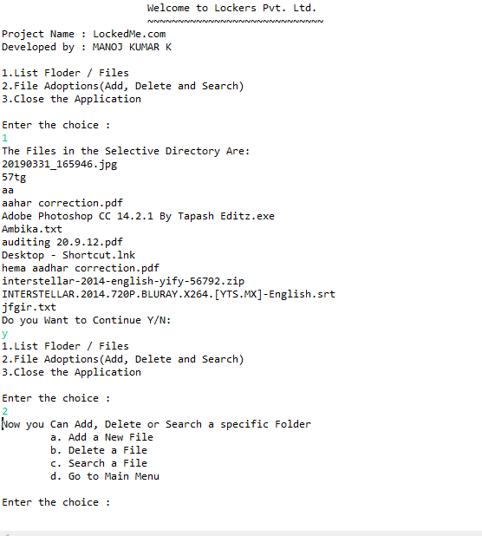
Sample Output 1

Slide 10
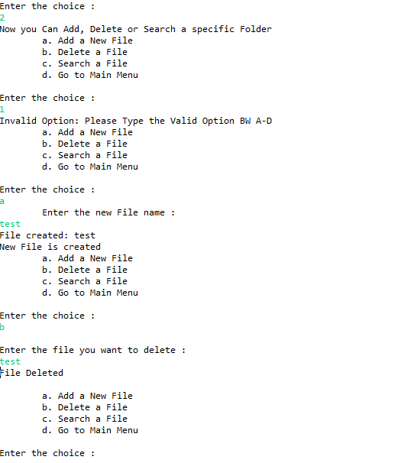
Sample Output 2

Slide 11
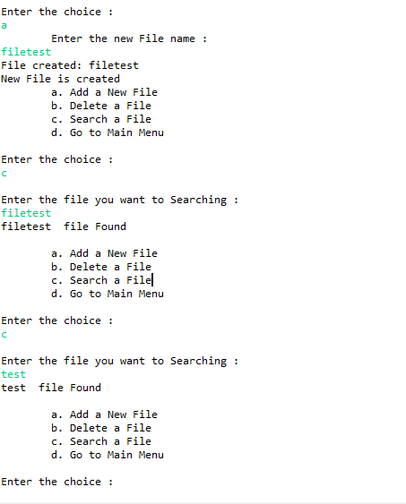
Sample Output 3

Slide 12
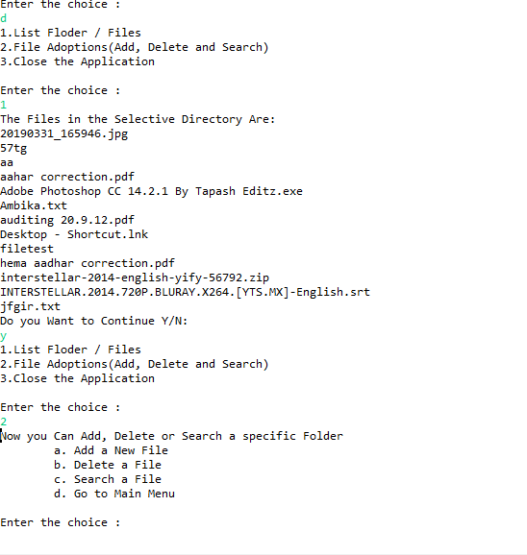
Sample Output 4

Slide 13

Thank You
Name : Manoj kumar k
Phone no: 7200663142
manojkumar720066@Gmail.com

